Slide 1




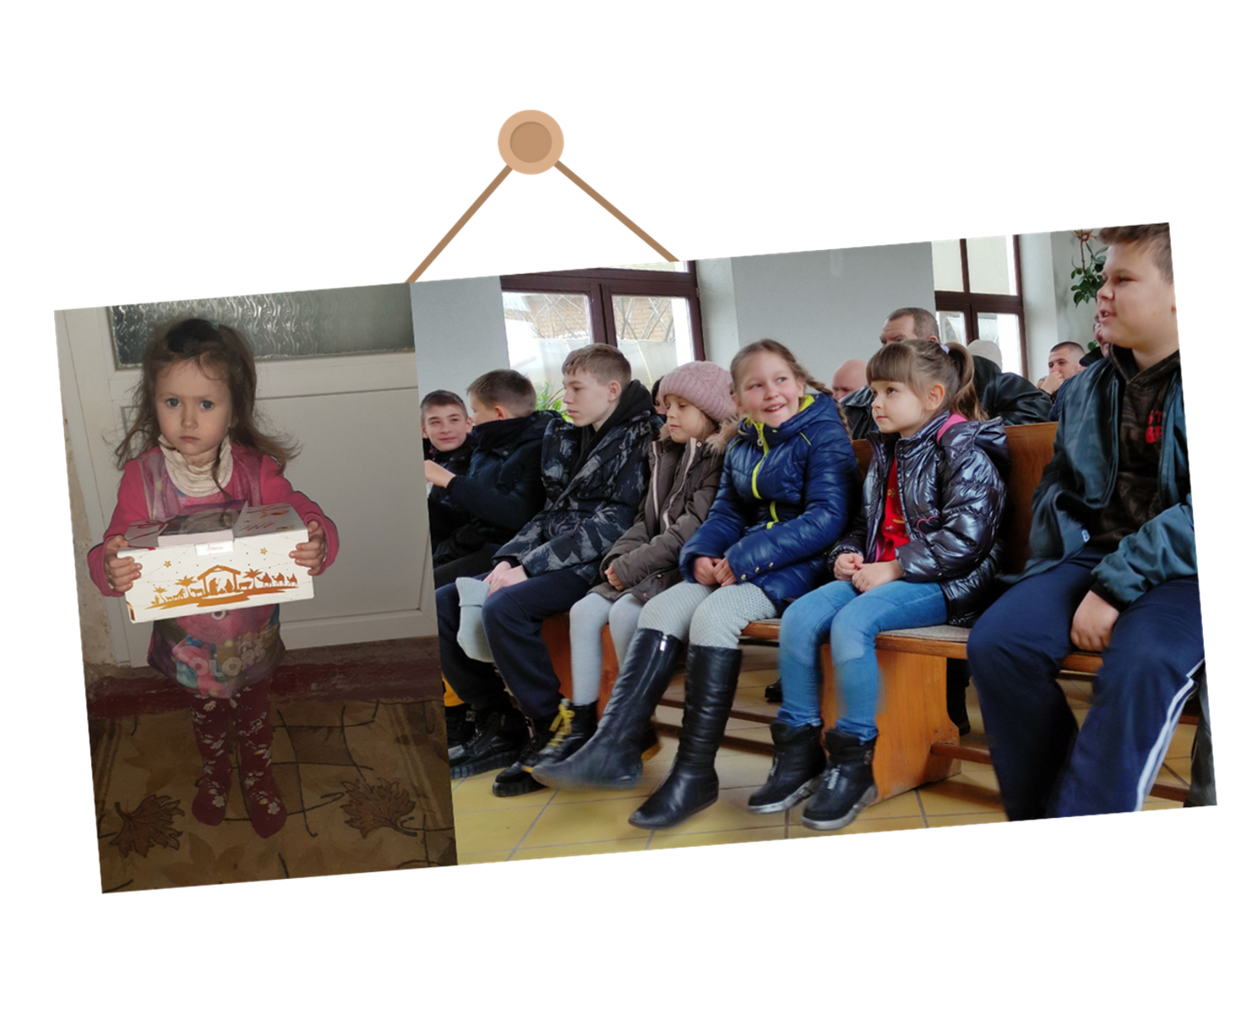




HEARTS FOR
JESUS
Helping Hands Eastern European Ministries

Slide 2

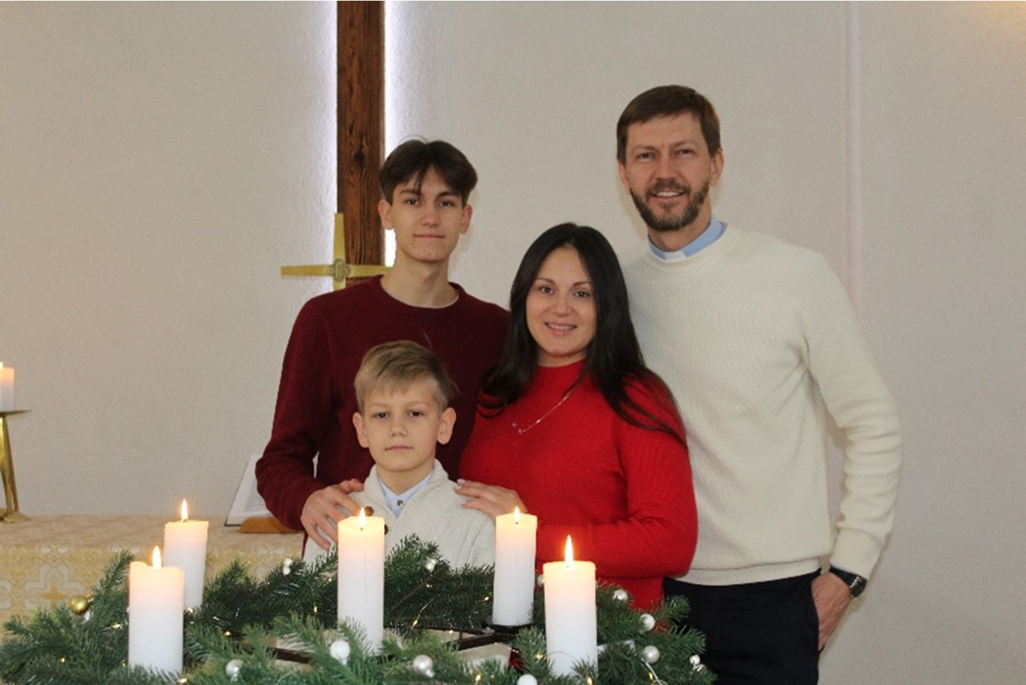

Rev. Oleksiy Navrotskyy - Ukrainian Pastor
The tall man in the picture is Pastor Oleksiy (“Alex”) Navrotskyy. He was born and raised in southern Ukraine.
For several years, he lived in Canada with his wife Victoria, sons Nikita and Illiya to attend seminary. They all learned English.
Other Ukrainian pastors trained in Canada, and worked hard building their congregations in Ukraine.

Slide 3

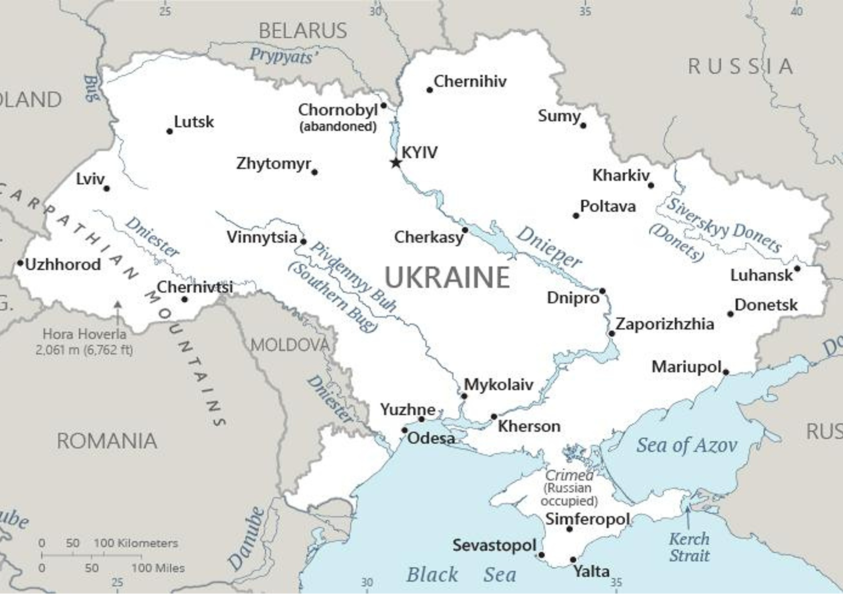

Mykolaiv, Ukraine
There was always a threat of another Russian invasion. Pastor Navrotskyy’smain congregation is in Mykoliav, pronounced “Mick o lee aiv”, Ukraine. This large city is in south central Ukraine and about a 30-minute drive to the Russian-occupied Crimea.

Slide 4
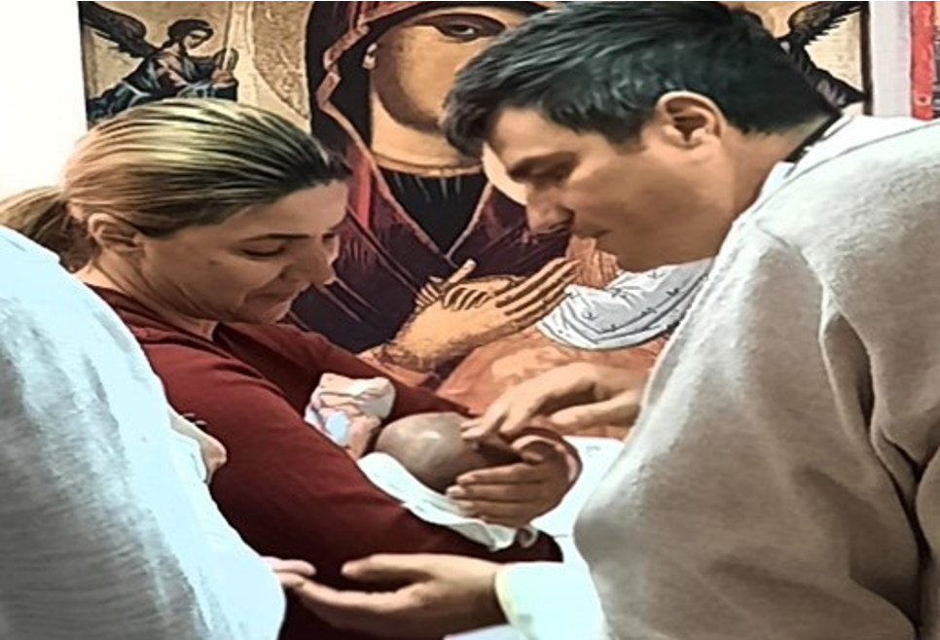

Pastor Sorin Trifa is pictured baptizing a newborn Ukrainian refugee. He and his family helped many Ukrainian refugees.
On February 24, 2022, Russia invaded Ukraine. At first, Pastor Navrotskyy and his family were fine. That changed a few days later. Through a resource, Pastor Navrotskyy was connected with Pastor Sorin Trifa and his congregation in Romania. They quickly helped both Pastor Navrotskky’s family and church members escape to safety in Romania. Many other Romanian Lutherans worked tirelessly to help other refugees.

Slide 5


How Can You Help?
Because of the war, food is hard to get. We want to help families be able to eat. Working with Pastor Navrotskyy’s church, Helping Hands Eastern European Ministries distributes the food.
Your offering or donation will help! For $16, a family will receive one food package a month.

Slide 6
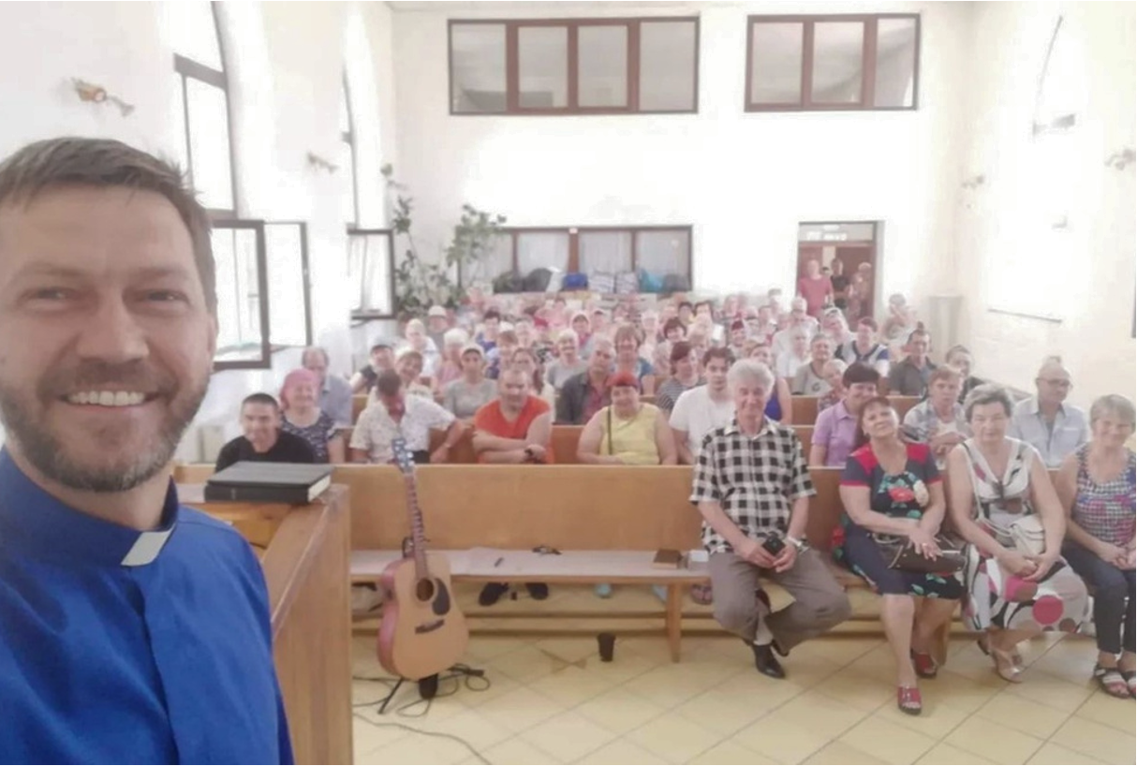
Despite the war, the Word continues to go on, help is received, and many Ukrainians are coming to faith.
These are an amazing people.
Hope in a dark place
Pastor Navrotskyy with
his congregation, July 2022

Slide 7

r
HEARTS FOR
JESUS
tkolb@se.lcms.org

Slide 8
r
HEARTS FOR
JESUS

